Slide 1

Capstone Presentation
Customer Churn – DTH-ecommerce
- Vishnuprabhakar Singh
GP-DSBA G1 APRIL-A 2020

Slide 2
CONTENTS
Business Problem Understanding
Exploratory Data Analysis
Model Development and Insights from Analysis
Recommendation and Conclusion

Slide 3
Business Problem Understanding
DTH companies face major challenge with customer churn, as customers switch to alternate provider due to various reasons like
Lower Cost
Customer Service Dissatisfaction
Multi (Combo) Service Offerings
Marketing Promotions By Competitors
Some of the constraints faced:
Inaccurate and missing Customer Data

Slide 4
Objective
Provide high Accuracy Model to identify Customer Attrition
Provide Strategies/Product offerings to retain Potential Churners
Avoid Revenue Loss and Retain Market Share
Insights into Internal Service factors causing Churn

Slide 5
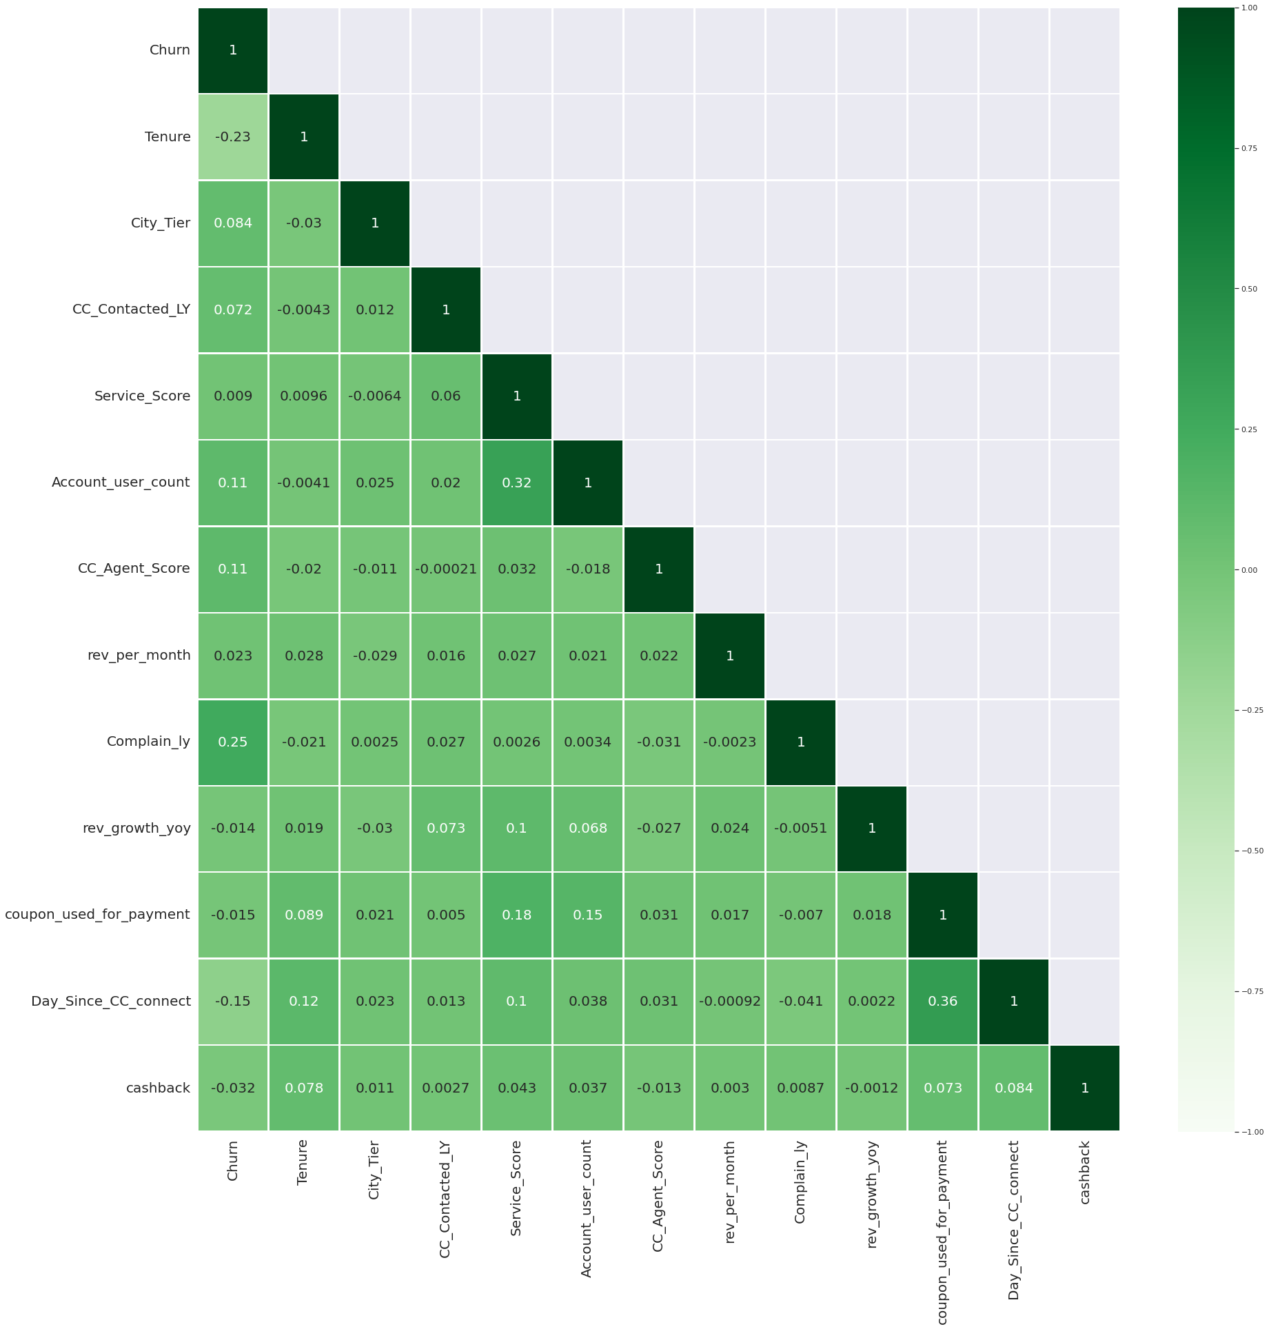
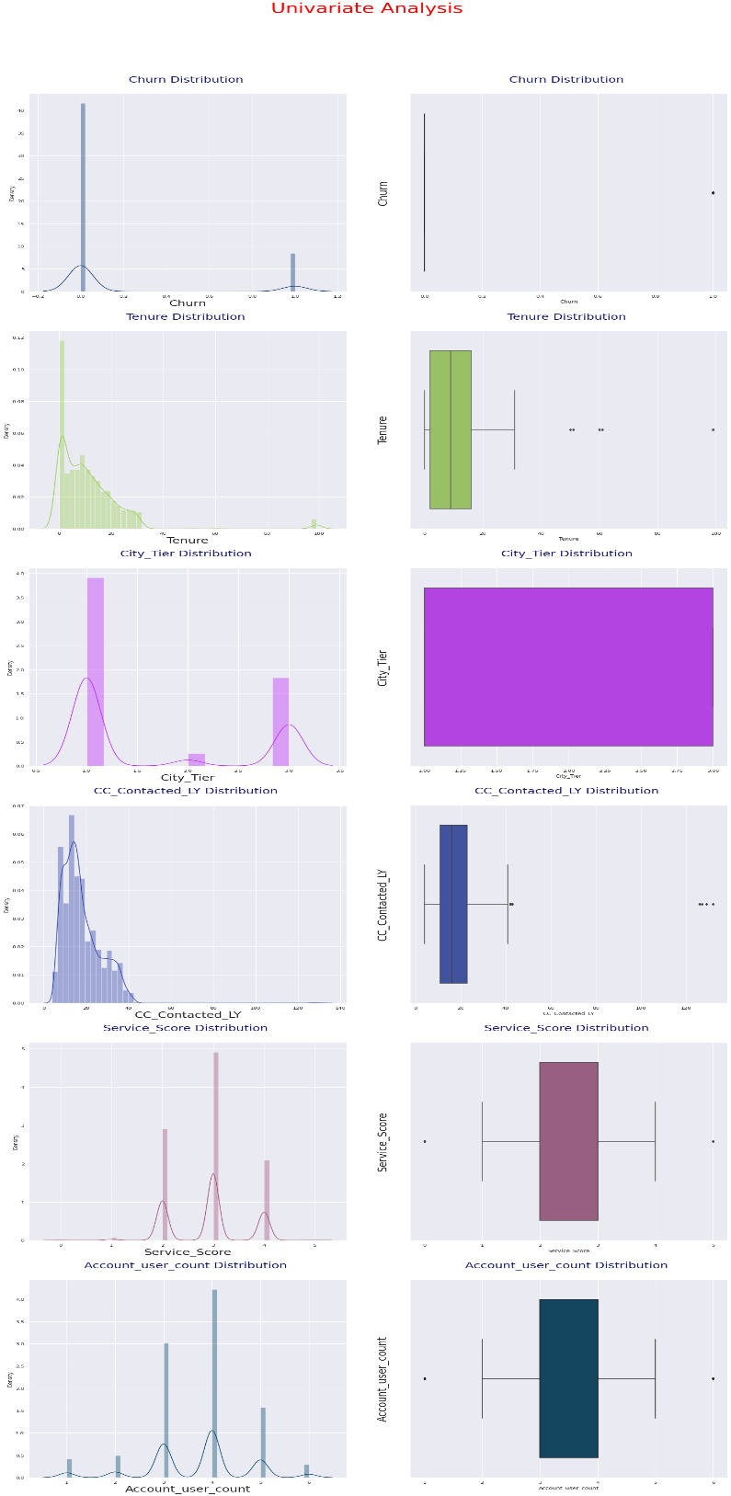
Exploratory Data Analysis
Multi-variate Analysis
Univariate Analysis

Slide 6
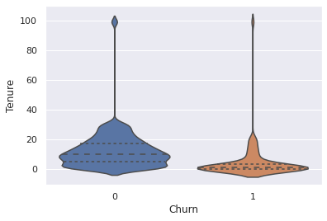
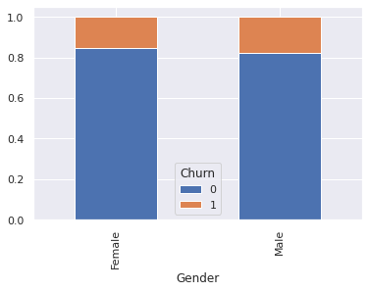
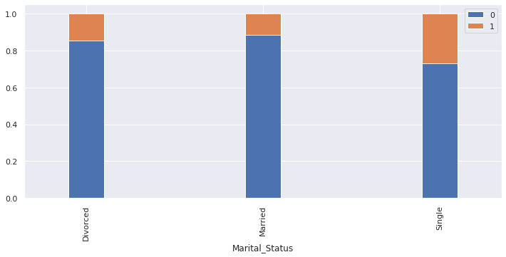
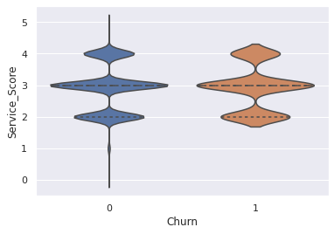
Exploratory Data Analysis
Bi-variate Analysis

Slide 7
Model Development
Various models were built and the below are the Optimal models that were selected for comparison.
Gradient Boosting
Artificial Neural Network
Logistic Regresssion
KNN

Slide 8
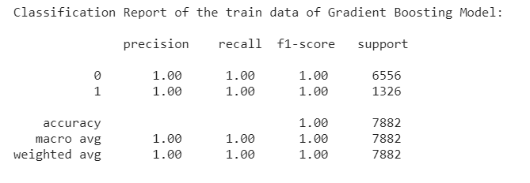
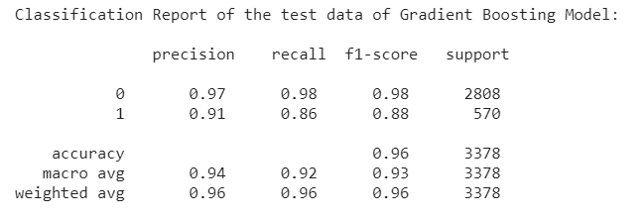

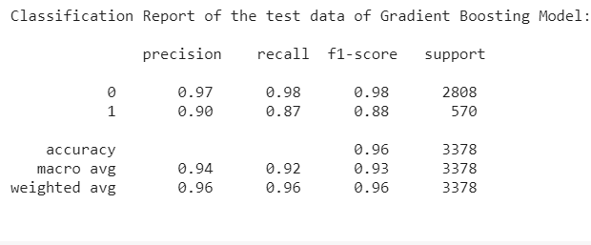
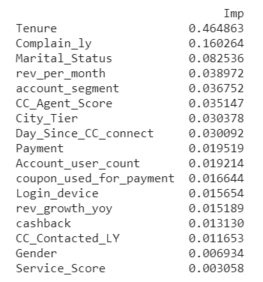
Model Development
Gradient Boosting Model
Pre-Smote
Model Performance implies that:
Performed equally well on Original and SMOTE Data
Prominent factors:
Tenure, Complaint_ly, Marital Status most prominent
Gender, Service_ Status least prominent
After Smote

Slide 9
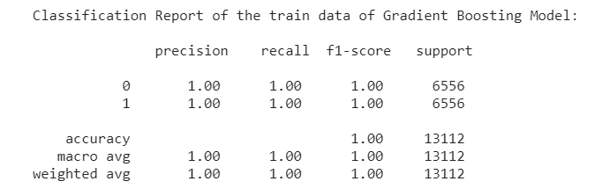
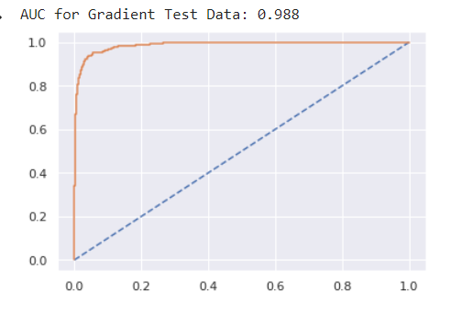
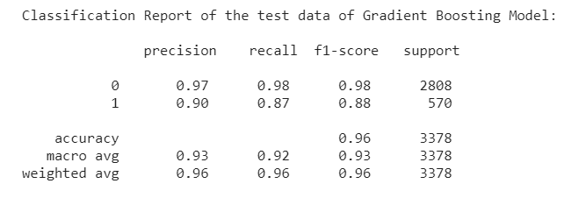
Model Development
Gradient Boosting Model
After Removing feature
Performance improved slightly after removing Gender and Service Score equally well on Original and SMOTE Data

Slide 10
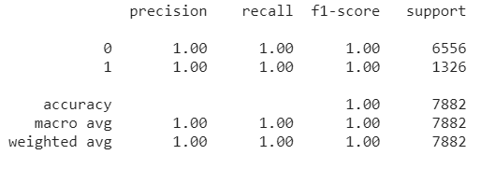
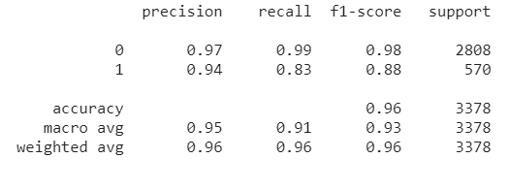
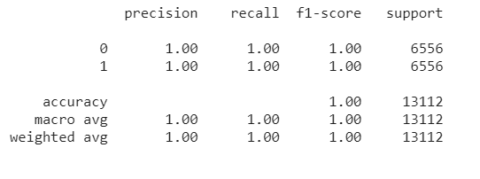
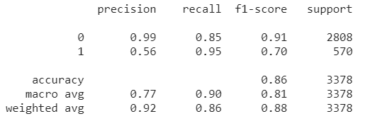
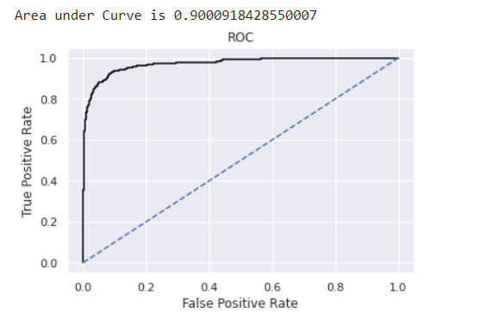
Model Development
ANN Model
Pre-Smote
Model Performance implies that:
Recall value improved on SMOTE Data
But Precision has taken a hit
Model is able to identify Churning customers well, but also falsely predicting non churners as Churner
After Smote

Slide 11
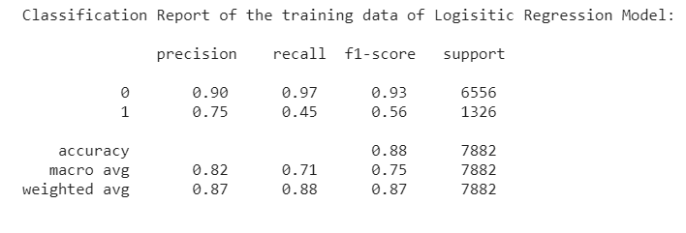
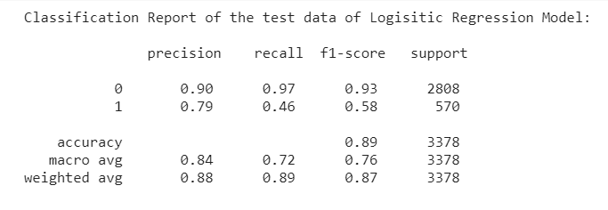
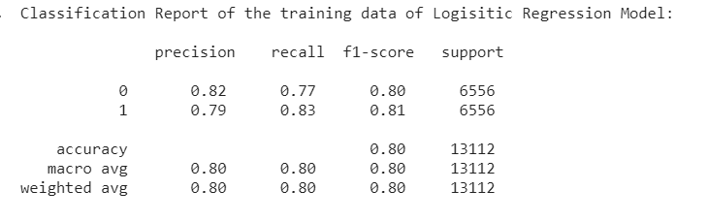
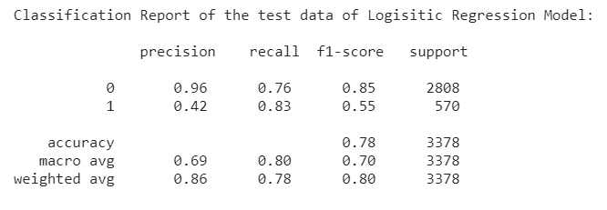
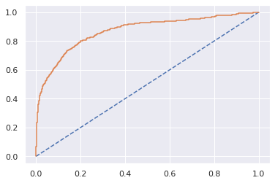
Model Development
Log. Reg Model
Pre-Smote
Model Performance implies that:
Recall value improved on SMOTE Data
But Precision has taken a hit
Also Model performance was not upto the level of satisfaction
After Smote

Slide 12
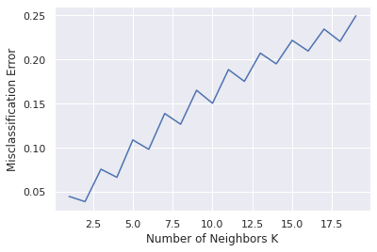
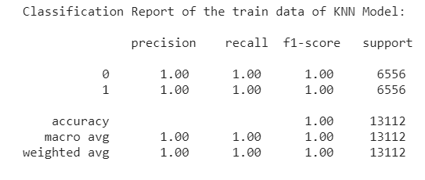
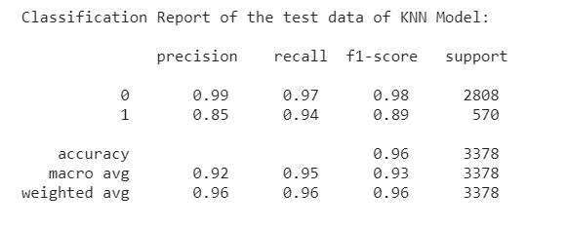
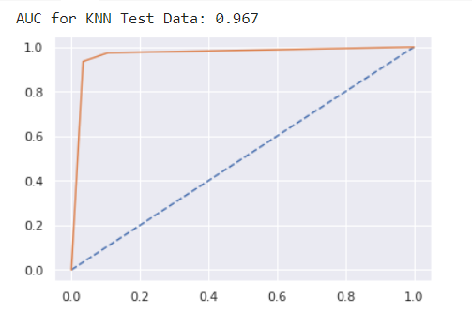
Model Development
KNN Model
13 significant variables are selected with k values 1 to 20, and optimal value of k comes out to be 2.
Performance of the model improved on the SMOTE Data

Slide 13
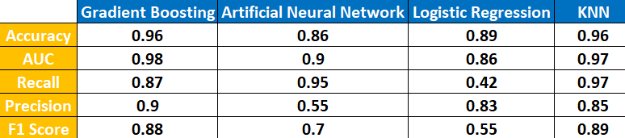
Model Summary
Various models are compared using factors using AUC Curve value, Accuracy and Sensitivity.
Gradient Boosting is the best model I have selected as:
Speed: Constructing weak models is computationally cheap.
Provides hind sights into various factors for churning
Often provides predictive accuracy that cannot be beat.
Lots of flexibility
Not much data pre-processing required

Slide 14
Insights and Recommendations
Insights:
Tenure: Customers with Tenure under 5 are most likely to churn
Marital Status and Complain seems to be playing major factors in churning
Customer Service score is not providing meaning insights into level of customer satisfaction
Recommendations to reduce customer churn;
Prioritize your top customers basis tenure, marital status, complaints and other key factors
Offer incentives
Proactive communication and ask for sensible feedbacks
Analyze churn to assess patterns for futures
Conclusion:
This research aimed to build a system which predicts the churn of the customers.
Potential Bleeding factors well identified

